Slide 1
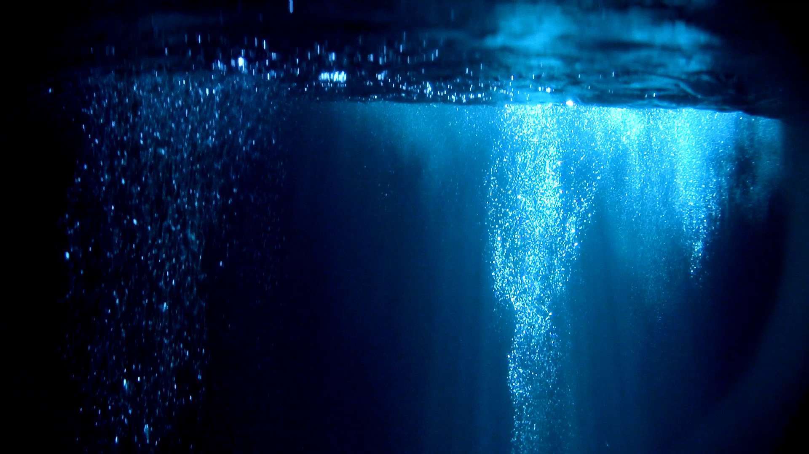
Methane Ocean World
A Planet of Liquid Methane Seas and Life

Slide 2
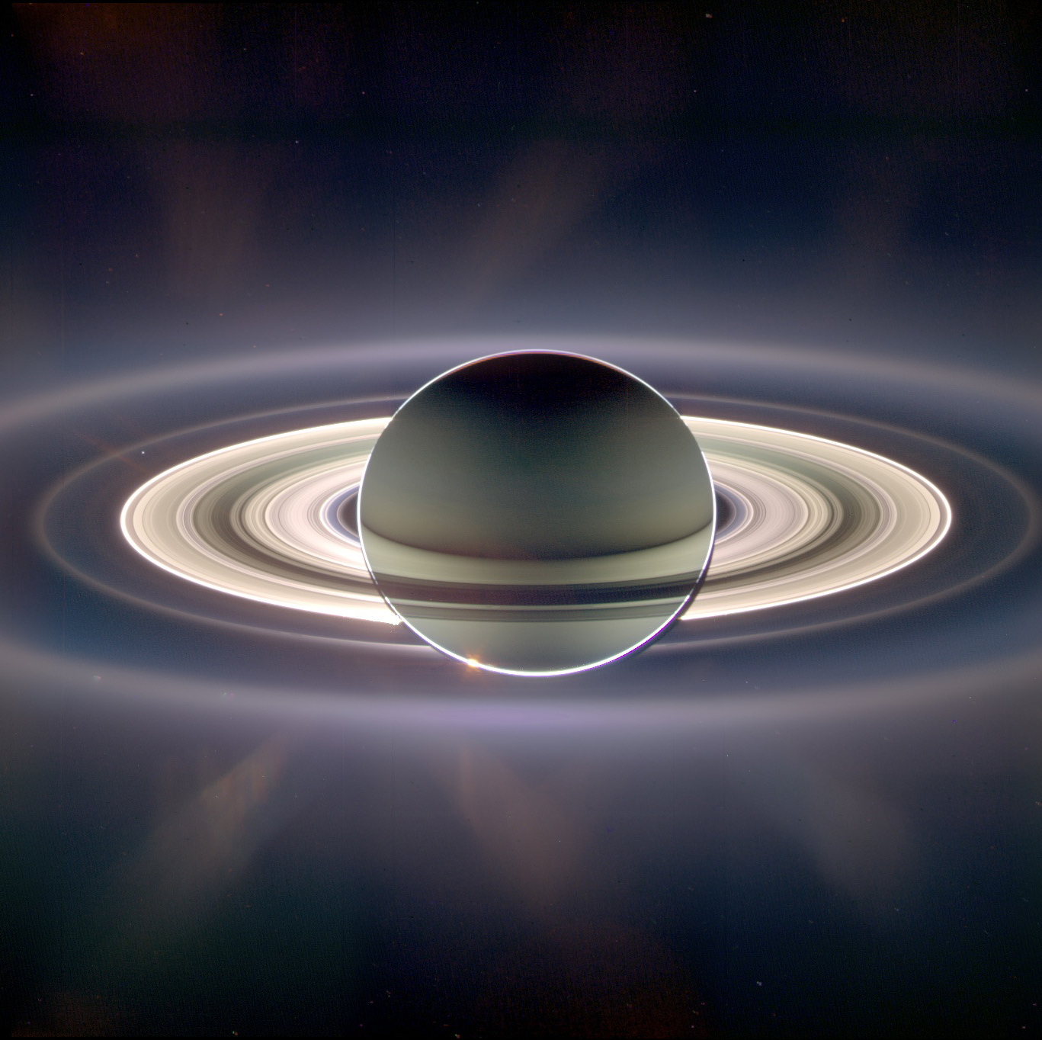
Planet Overview
The planet is fully covered by liquid methane oceans.
A methane-rich atmosphere keeps the climate warm and stable.
Frequent storms occur due to the high concentration of methane gas.

Slide 3

Environmental Structure
High methane levels create high-pressure conditions.
The ocean floor is rich in minerals and supports marine
life.Life thrives in underwater ecosystems.

Slide 4
Planetary Ecosystem
Life on the planet revolves around methane and minerals.
Species interact symbiotically to maintain ecosystem balance.
Energy production and waste cleaning are crucial for species survival.

Slide 5
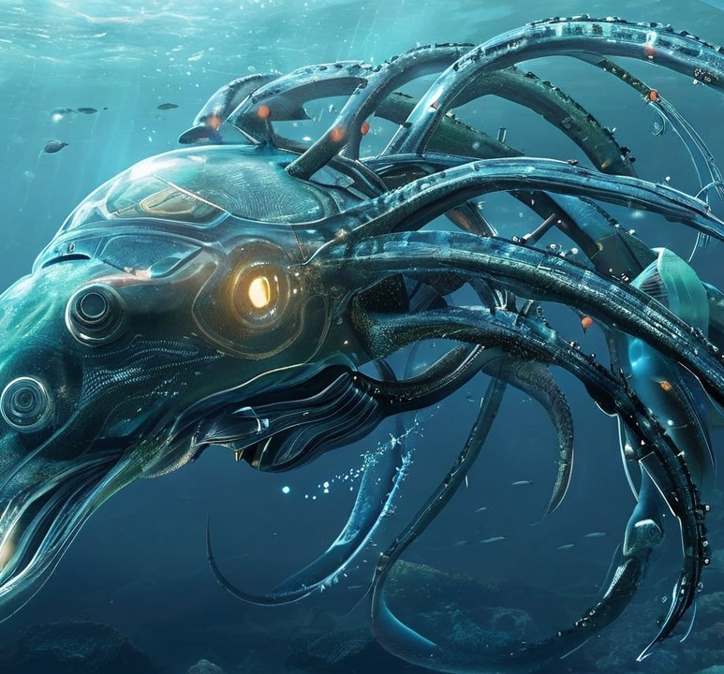
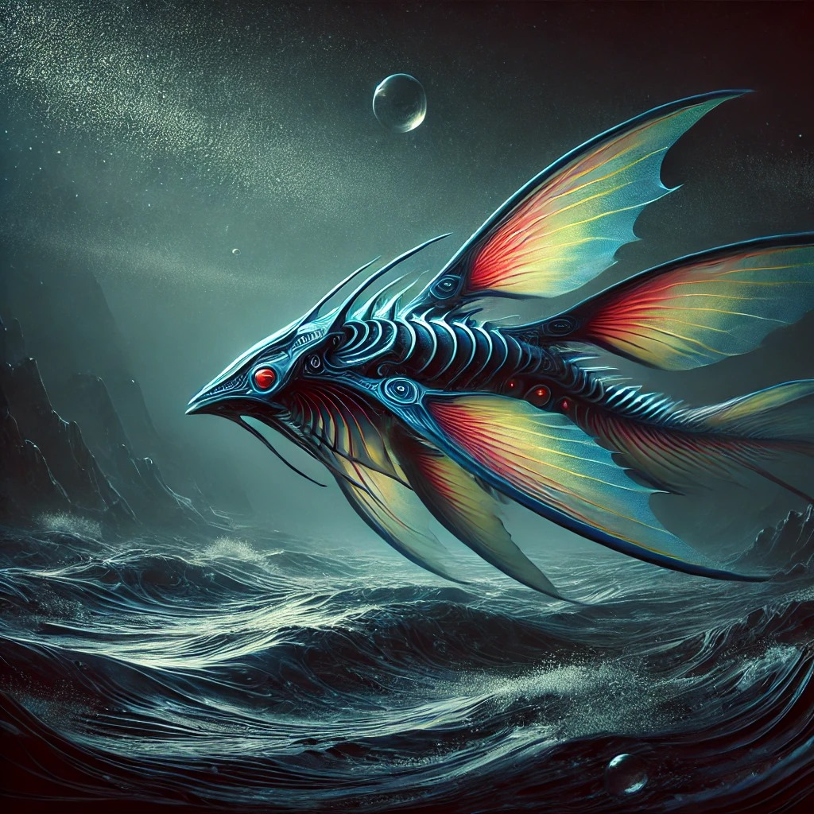
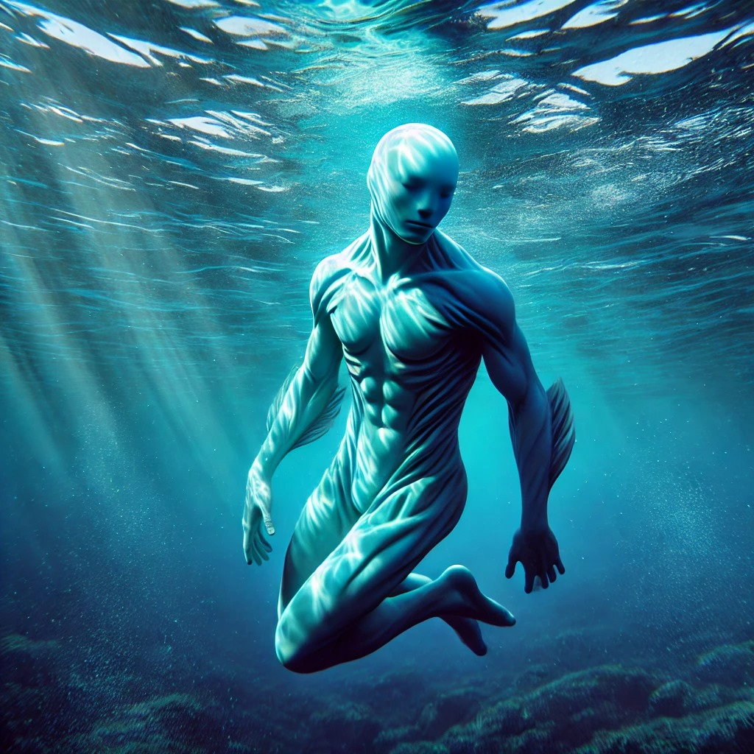
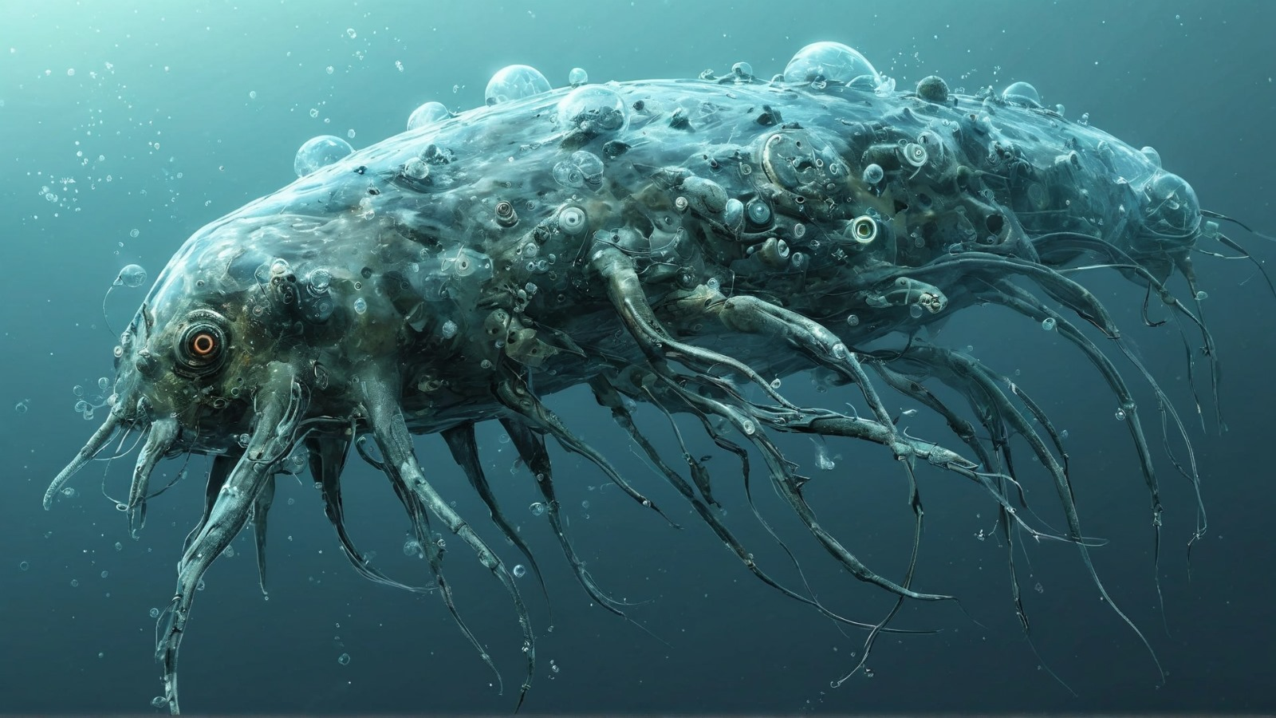
Main Life Forms
Hidro Saphiens: Advanced surface species using chemosynthesis.
Hidro Korallus: Deep-sea species absorbing minerals.
Hidro Sonarix: Mid-sea cleaners that process waste.
Hidro Velocimeth: Surface dwellers that convert methane into energy.

Slide 6
Ecosystem Balance
Producers: Hidro Korallus creates organic matter from minerals.
Consumers: Hidro Velocimeth and others rely on nutrients from Korallus.
Hidro Saphiens maintain balance by regulating population.

Slide 7
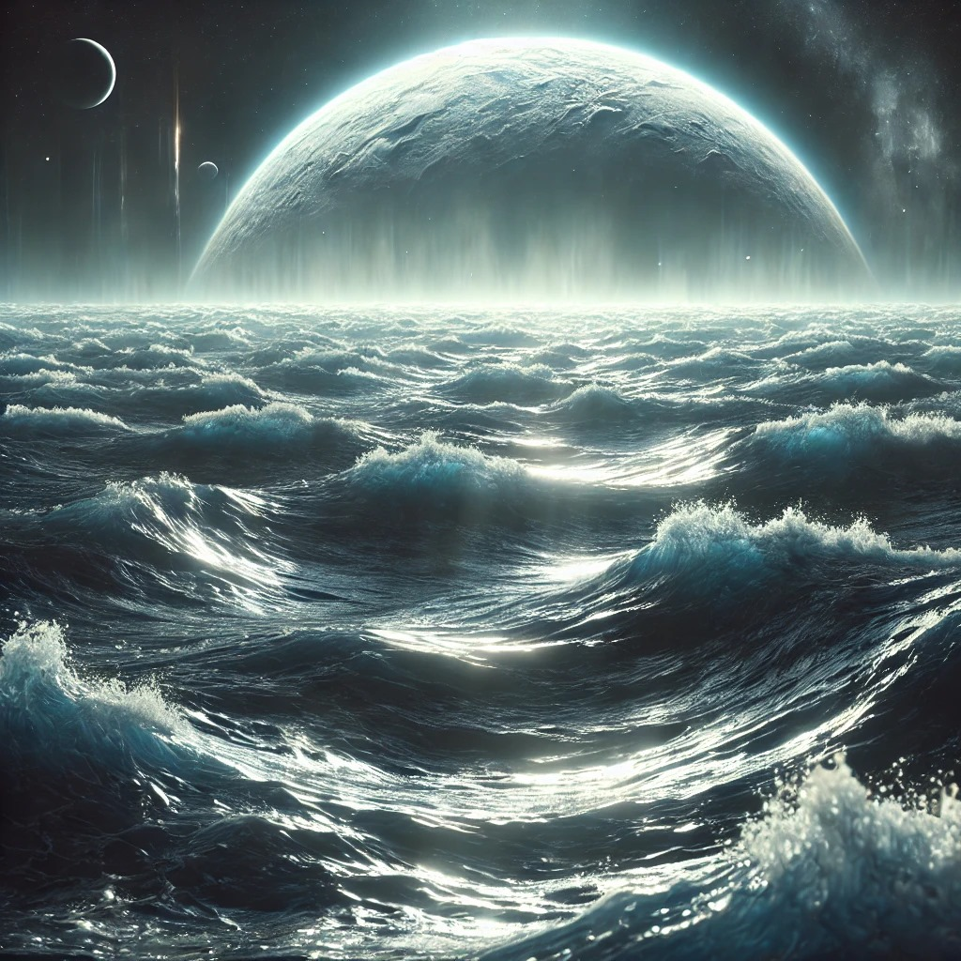
The Future of Life
This methane-based world thrives on delicate ecosystem balance.
Future exploration could reveal more about species evolution and technological advancements.

